Slide 1
Kubernetes in Action
Part VII
2026.08.25

Slide 2
Securing The API Server
Roles and Authentication

Slide 3
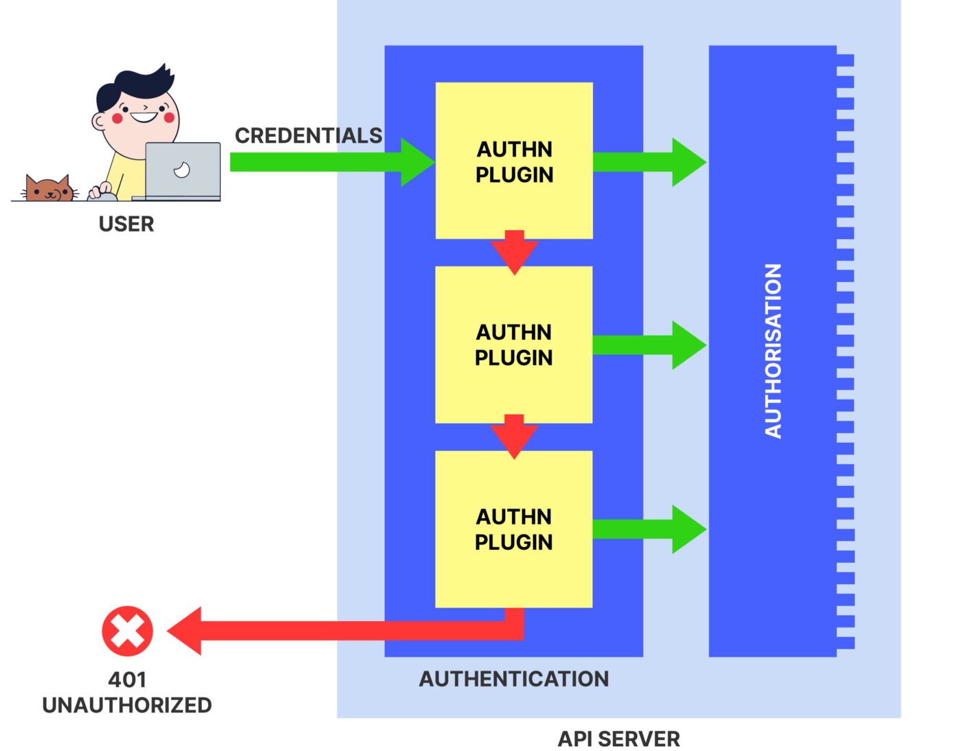
Understanding Authentication(1/12)
The API Server Authentication :
  The API server can be configured with one or more authentication plugins (and the same is true for authorization plugins). When a request is received by the API server, it goes through the list of authentication plugins, so they can each examine the request and try to determine who’s sending the request. The first plugin that can extract that information from the request returns the username, user ID, and the groups the client belongs to back to the API server core. The API server stops invoking the remaining authentication plugins and continues onto the authorization phase.
  Several authentication plugins are available. They obtain the identity of the client using the following methods :
    From the client certificate
    From an authentication token passed in an HTTP header
    Basic HTTP authentication
    Others
  The authentication plugins are enabled through command-line options when starting the API server.

Slide 4
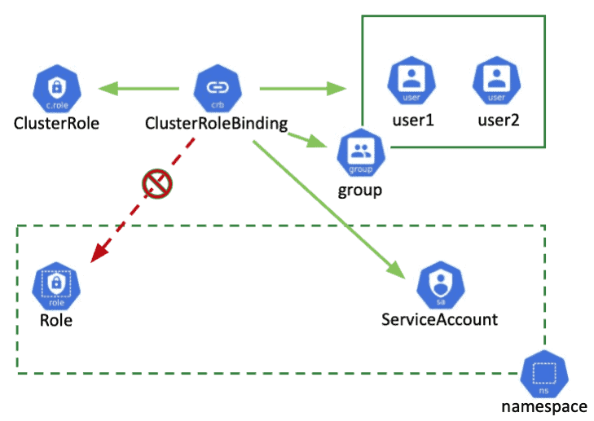
Understanding Authentication(2/12)
Users and Groups :
  An authentication plugin returns the username and group(s) of the authenticated user. Kubernetes doesn’t store that information anywhere; it uses it to verify whether the user is authorized to perform an action or not.
  Kubernetes distinguishes between two kinds of clients connecting to the API server :
    Actual humans (users)
    Pods (more specifically, applications running inside them)
  Both these types of clients are authenticated using the aforementioned authentication plugins. Users are meant to be managed by an external system, such as a Single Sign On (SSO) system, but the pods use a mechanism called service accounts, which are created and stored in the cluster as ServiceAccount resources. In contrast, no resource represents user accounts, which means you can’t create, update, or delete users through the API server.
  For more information on how to configure the cluster for authentication of human users, cluster administrators should refer to the Kubernetes Cluster Administrator guide at http://kubernetes.io/docs/admin.

Slide 5
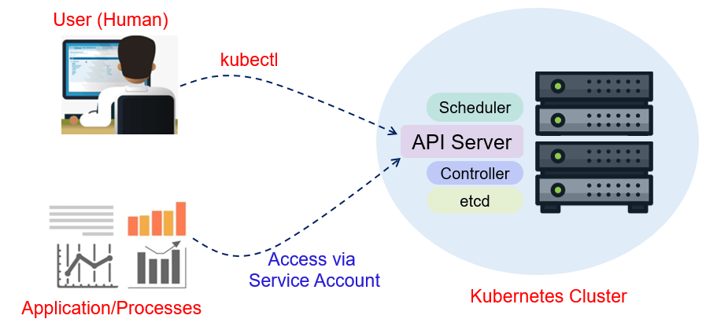
Understanding Authentication(3/12)
Users and Groups :
  Both human users and ServiceAccounts can belong to one or more groups. We’ve said that the authentication plugin returns groups along with the username and user ID. Groups are used to grant permissions to several users at once, instead of having to grant them to individual users.
  Groups returned by the plugin are nothing but strings, representing arbitrary group names, but built-in groups have special meaning :
    The system:unauthenticated group is used for requests where none of the authentication plugins could authenticate the client.
    The system:authenticated group is automatically assigned to a user who was authenticated successfully.
    The system:serviceaccounts group encompasses all ServiceAccounts in the system.
    The system:serviceaccounts:<namespace> includes all ServiceAccounts in a specific namespace.

Slide 6
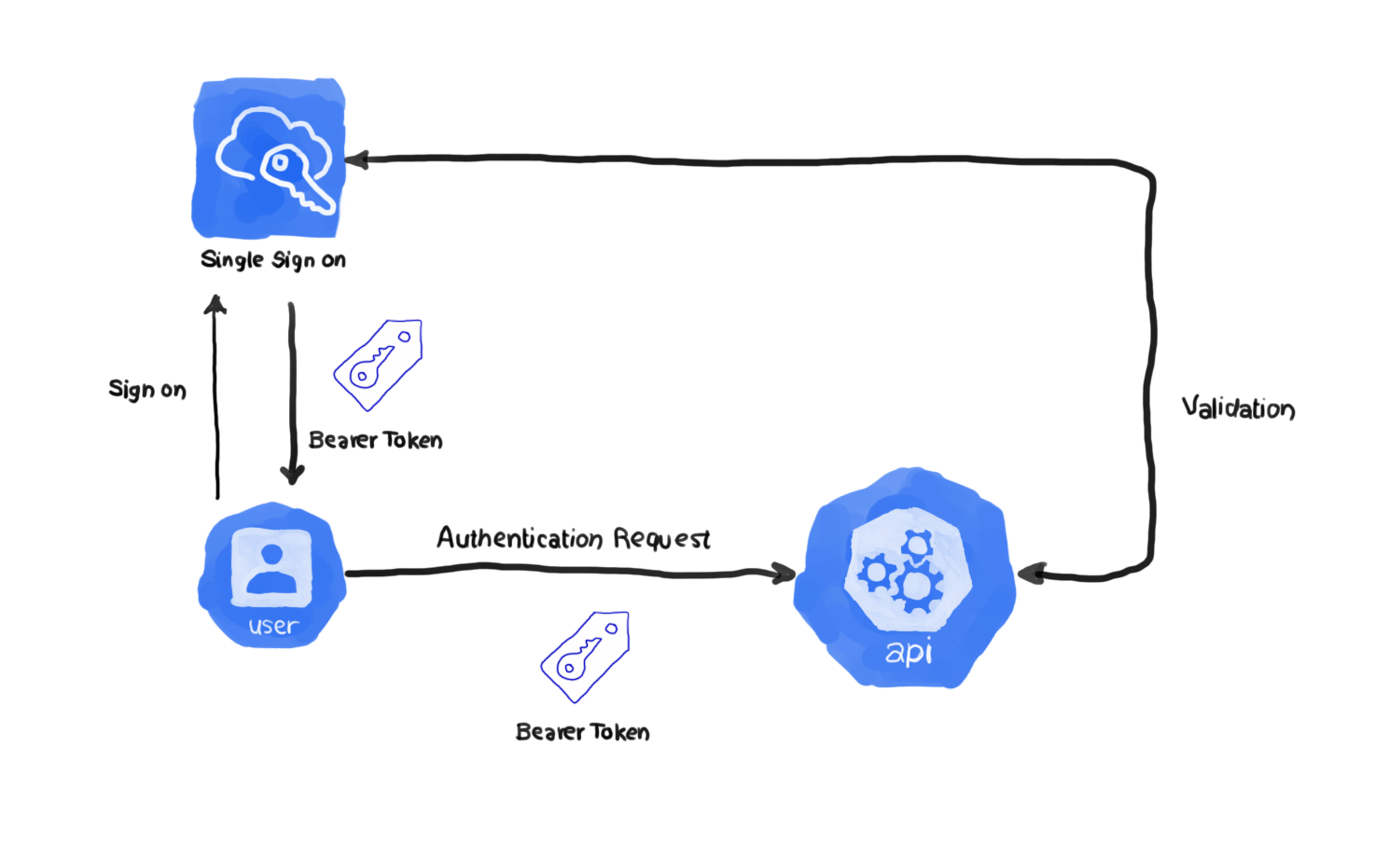
Understanding Authentication(4/12)
ServiceAccounts :
  The API server requires clients to authenticate themselves before they’re allowed to perform operations on the server. And you’ve already seen how pods can authenticate by sending the contents of the file “/var/run/secrets/kubernetes.io/serviceaccount/token”, which is mounted into each container’s filesystem through a secret volume.
  Every pod is associated with a ServiceAccount, which represents the identity of the app running in the pod. The token file holds the ServiceAccount’s authentication token. When an app uses this token to connect to the API server, the authentication plugin authenticates the ServiceAccount and passes the ServiceAccount’s username back to the API server core.
  ServiceAccount usernames are formatted like this :
  The API server passes this username to the configured authorization plugins, which determine whether the action the app is trying to perform is allowed to be performed by the ServiceAccount.
system:serviceaccount:<namespace>:<service account name>

Slide 7
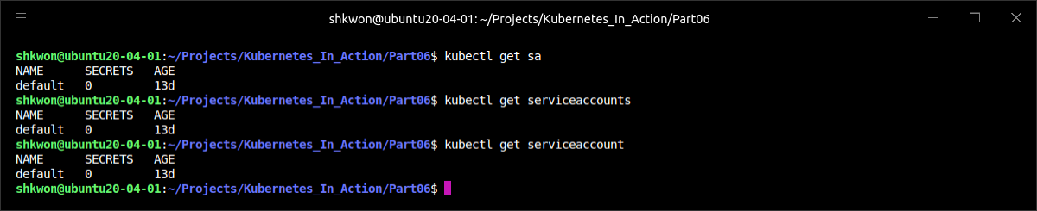
Understanding Authentication(5/12)
ServiceAccounts :
  ServiceAccounts are nothing more than a way for an application running inside a pod to authenticate itself with the API server. As already mentioned, applications do that by passing the ServiceAccount’s token in the request.
  ServiceAccounts are resources just like Pods, Secrets, ConfigMaps, and so on, and are scoped to individual namespaces. A default ServiceAccount is automatically created for each namespace (that’s the one your pods have used all along).
  You can list ServiceAccounts like you do other resources :
$ kubectl get serviceaccounts

Slide 8
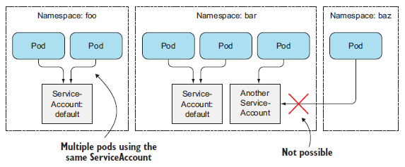
Understanding Authentication(6/12)
ServiceAccounts :
  As you can see from the previous screenshot, the current namespace only contains the default ServiceAccount. Additional ServiceAccounts can be added when required. Each pod is associated with exactly one ServiceAccount, but multiple pods can use the same ServiceAccount. As you can see in the following figure, a pod can only use a ServiceAccount from the same namespace.

Slide 9
Understanding Authentication(7/12)
ServiceAccounts :
  You can assign a ServiceAccount to a pod by specifying the account’s name in the pod manifest. If you don’t assign it explicitly, the pod will use the default ServiceAccount in the namespace.
  By assigning different ServiceAccounts to pods, you can control which resources each pod has access to. When a request bearing the authentication token is received by the API server, the server uses the token to authenticate the client sending the request and then determines whether or not the related ServiceAccount is allowed to perform the requested operation. The API server obtains this information from the system-wide authorization plugin configured by the cluster administrator. One of the available authorization plugins is the role-based access control (RBAC) plugin. From Kubernetes version 1.6 on, the RBAC plugin is the plugin most clusters should use.

Slide 10
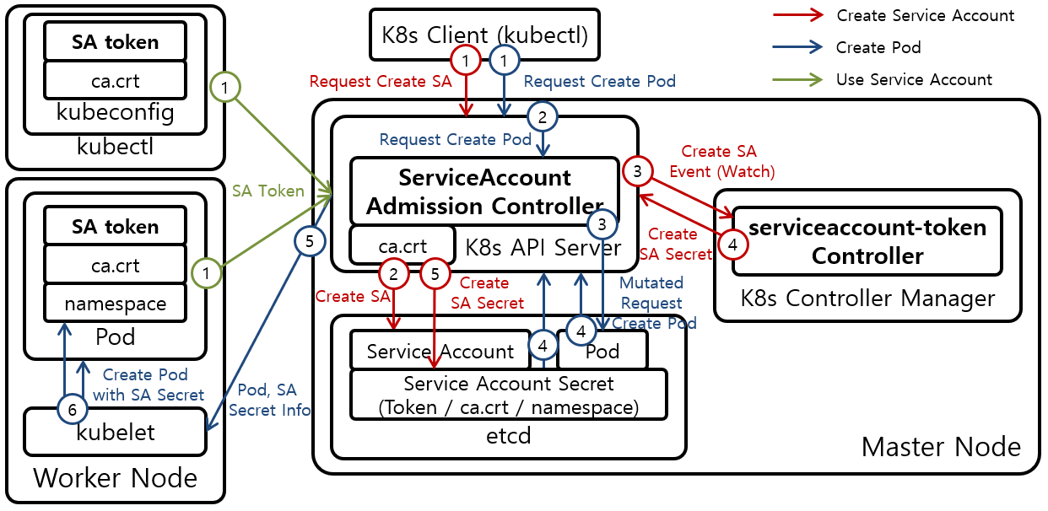
Understanding Authentication(8/12)
Creating ServiceAccounts :
  We’ve said every namespace contains its own default ServiceAccount, but additional ones can be created if necessary. But why should you bother with creating ServiceAccounts instead of using the default one for all your pods?
  The obvious reason is cluster security. Pods that don’t need to read any cluster metadata should run under a constrained account that doesn’t allow them to retrieve or modify any resources deployed in the cluster. Pods that need to retrieve resource metadata should run under a ServiceAccount that only allows reading those objects’ metadata, whereas pods that need to modify those objects should run under their own ServiceAccount allowing modifications of API objects.

Slide 11
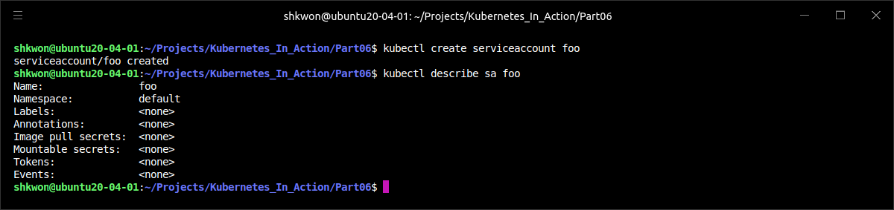
Understanding Authentication(9/12)
Creating ServiceAccounts :
  To create a ServiceAccount, you can use “$ kubectl create serviceaccount” command. Let’s create a new ServiceAccount called foo :
  Now, you can inspect the ServiceAccount with the “describe” command.
  NOTE : You’ve probably heard of JSON Web Tokens (JWT). The authentication tokens used in ServiceAccounts are JWT tokens.
  You can also use “describe” command to see more detailed information of the secret with “$ kubectl describe secret <TOKEN NAME>” command if there is a token in the above screenshot. Here we don’t have.
$ kubectl create serviceaccount foo

Slide 12
Understanding Authentication(10/12)
Creating ServiceAccounts :
  The token will be shown in the Mountable secrets list when you inspect a ServiceAccount with “$ kubectl describe” command. By default, a pod can mount any Secret it wants. But the pod’s ServiceAccount can be configured to only allow the pod to mount Secrets that are listed as mountable Secrets on the ServiceAccount. To enable this feature, the ServiceAccount must contain the following annotation :
  If the ServiceAccount is annotated with this annotation, any pods using it can mount only the ServiceAccount’s mountable Secrets—they can’t use any other Secret.
  A ServiceAccount can also contain a list of image pull Secrets. In case you don’t remember, they are Secrets that hold the credentials for pulling container images from a private image repository.
  The following listing shows an example of a ServiceAccount definition, which includes the image pull Secret you created before.
  A ServiceAccount’s image pull Secrets behave slightly differently than its mountable Secrets. Unlike mountable Secrets, they don’t determine which image pull Secrets a pod can use, but which ones are added automatically to all pods using the ServiceAccount. Adding image pull Secrets to a ServiceAccount saves you from having to add them to each pod individually.
kubernetes.io/enforce-mountable-secrets="true"
apiVersion: v1
kind: ServiceAccount
metadata:
name: my-service-account
imagePullSecrets:
- name: my-dockerhub-secret
sa-image-pull-secrets.yaml

Slide 13
Understanding Authentication(11/12)
Assigning a ServiceAccounts to a Pod :
  After you create additional ServiceAccounts, you need to assign them to pods. This is done by setting the name of the ServiceAccount in the “spec.serviceAccountName” field in the pod definition.
  NOTE : A pod’s ServiceAccount must be set when creating the pod. It can’t be changed later.
  You already deployed a pod that ran a container based on the “knix008/curl” image and an ambassador container alongside it before. You used it to explore the API server’s REST interface. The ambassador container ran the “kubectl proxy” process, which used the pod’s ServiceAccount’s token to authenticate with the API server.
  You can now modify the pod so it uses the foo ServiceAccount you created minutes ago. The next listing shows the pod definition.
apiVersion: v1
kind: Pod
metadata:
name: curl-custom-sa
spec:
serviceAccountName: foo
containers:
- name: main
image: knix008/curl:latest
command: ["sleep", "9999999"]
- name: ambassador
image: knix008/kubectl-proxy:latest
curl-custom-sa.yaml

Slide 14
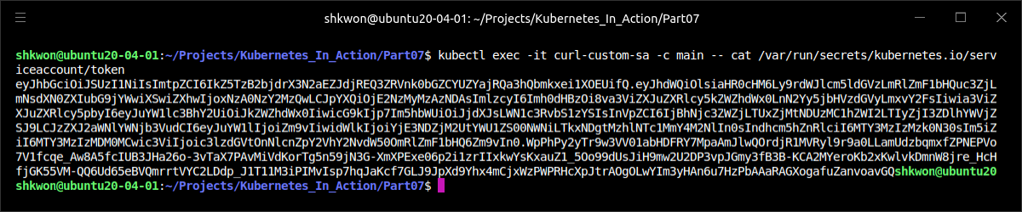
Understanding Authentication(12/12)
Assigning a ServiceAccounts to a Pod :
  To confirm that the custom ServiceAccount’s token is mounted into the two containers, you can print the contents of the token as shown in the following listing.
  NOTE : The token is the one from the “foo” ServiceAccount.
$ kubectl create -f curl-custom-sa.yaml
$ kubectl exec -it curl-custom-sa -c main -- cat /var/run/secrets/kubernetes.io/serviceaccount/token

Slide 15
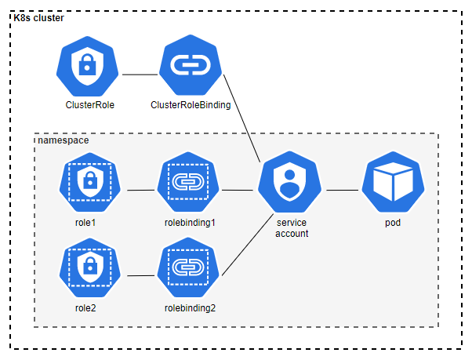
Securing the Cluster with Role-Based Access Control(RBAC)(1/46)
RBAC :
  Starting with Kubernetes version 1.6.0, cluster security was ramped up considerably. In earlier versions, if you managed to acquire the authentication token from one of the pods, you could use it to do anything you want in the cluster. If you google around, you’ll find demos showing how a path traversal (or directory traversal) attack (where clients can retrieve files located outside of the web server’s web root directory) can be used to get the token and use it to run your malicious pods in an insecure Kubernetes cluster.
  But in version 1.8.0, the RBAC authorization plugin graduated to GA (General Availability) and is now enabled by default on many clusters (for example, when deploying a cluster with kubadm). RBAC prevents unauthorized users from viewing or modifying the cluster state. The default ServiceAccount isn’t allowed to view cluster state, let alone modify it in any way, unless you grant it additional privileges. To write apps that communicate with the Kubernetes API server, you need to understand how to manage authorization through RBAC-specific resources.
  NOTE : In addition to RBAC, Kubernetes also includes other authorization plugins, such as the Attribute-based access control (ABAC) plugin, a WebHook plugin and custom plugin implementations. RBAC is the standard, though.

Slide 16
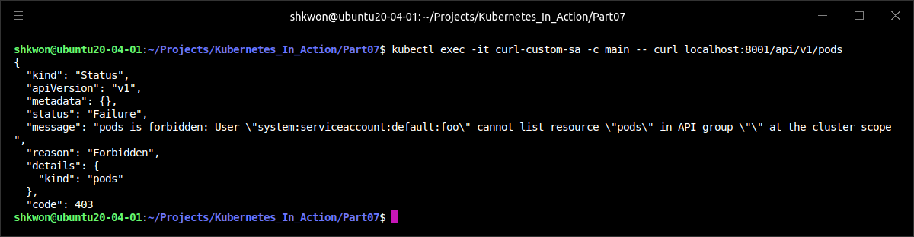
Securing the Cluster with Role-Based Access Control(RBAC)(2/46)
RBAC :
  When you run the following command, you can find the error response from the API server.
  NOTE : From the above screenshot, the “foo” is the default ServiceAccount. And it cannot list all the pods in cluster scope.
$ kubectl exec -it curl-custom-sa -c main – curl localhost:8001/api/v1/pods

Slide 17
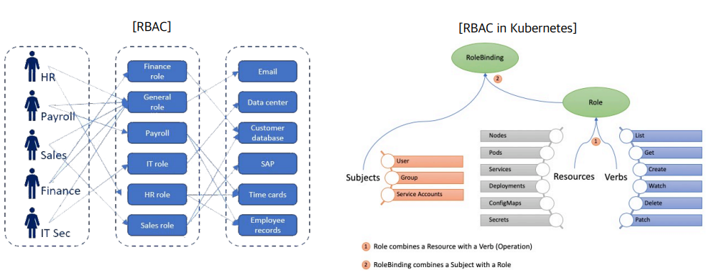
Securing the Cluster with Role-Based Access Control(RBAC)(3/46)
Introducing the RBAC Authorization Plugin :
  The Kubernetes API server can be configured to use an authorization plugin to check whether an action is allowed to be performed by the user requesting the action. Because the API server exposes a REST interface, users perform actions by sending HTTP requests to the server. Users authenticate themselves by including credentials in the request (an authentication token, username and password, or a client certificate).
  REST clients send GET, POST, PUT, DELETE, and other types of HTTP requests to specific URL paths, which represent specific REST resources. In Kubernetes, those resources are Pods, Services, Secrets, and so on.
  Here are a few examples of actions in Kubernetes :
    Get Pods
    Create Services
    Update Secrets
    And so on

Slide 18
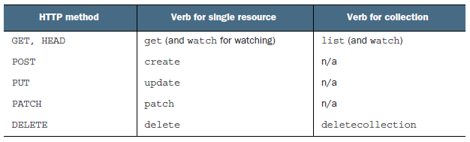
Securing the Cluster with Role-Based Access Control(RBAC)(4/46)
Introducing the RBAC Authorization Plugin :
  The verbs in those examples (get, create, update) map to HTTP methods (GET, POST, PUT) performed by the client (the complete mapping is shown in the following table). The nouns (Pods, Service, Secrets) obviously map to Kubernetes resources.
  An authorization plugin such as RBAC, which runs inside the API server, determines whether a client is allowed to perform the requested verb on the requested resource or not.
  NOTE : The additional verb use is used for PodSecurityPolicy resources.
  Besides applying security permissions to whole resource types, RBAC rules can also apply to specific instances of a resource (for example, a Service called “myservice”). And later you’ll see that permissions can also apply to non-resource URL paths, because not every path the API server exposes maps to a resource (such as the “/api” path itself or the server health information at “/healthz”).

Slide 19
Securing the Cluster with Role-Based Access Control(RBAC)(5/46)
Introducing the RBAC Authorization Plugin :
  The RBAC authorization plugin, as the name suggests, uses user roles as the key factor in determining whether the user may perform the action or not. A subject (which may be a human, a ServiceAccount, or a group of users or ServiceAccounts) is associated with one or more roles and each role is allowed to perform certain verbs on certain resources.
  If a user has multiple roles, they may do anything that any of their roles allows them to do. If none of the user’s roles contains a permission to, for example, update Secrets, the API server will prevent the user from performing PUT or PATCH requests on Secrets.
  Managing authorization through the RBAC plugin is simple. It’s all done by creating four RBAC-specific Kubernetes resources, which we’ll look at next.

Slide 20
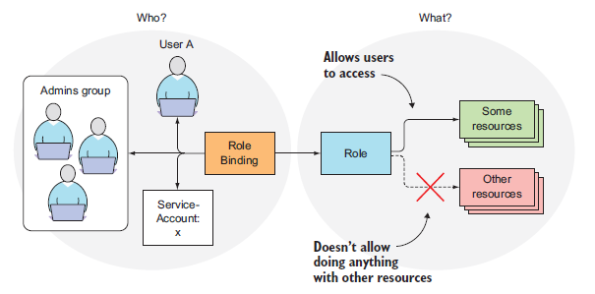
Securing the Cluster with Role-Based Access Control(RBAC)(6/46)
Introducing RBAC Resources :
  The RBAC authorization rules are configured through four resources, which can be grouped into two groups :
    Roles and ClusterRoles, which specify which verbs can be performed on which resources.
    RoleBindings and ClusterRoleBindings, which bind the above roles to specific users, groups, or ServiceAccounts.
  Roles define what can be done, while bindings define who can do it (this is shown in the following figure).

Slide 21
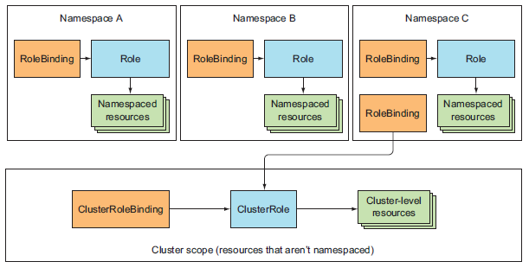
Securing the Cluster with Role-Based Access Control(RBAC)(7/46)
Introducing RBAC Resources :
  The distinction between a Role and a ClusterRole, or between a RoleBinding and a ClusterRoleBinding, is that the Role and RoleBinding are namespaced resources, whereas the ClusterRole and ClusterRoleBinding are cluster-level resources (not namespaced). This is depicted in the following figure.
  As you can see from the figure, multiple RoleBindings can exist in a single namespace (this is also true for Roles). Likewise, multiple ClusterRoleBindings and ClusterRoles can be created. Another thing shown in the figure is that although RoleBindings are namespaced, they can also reference ClusterRoles, which aren’t.

Slide 22
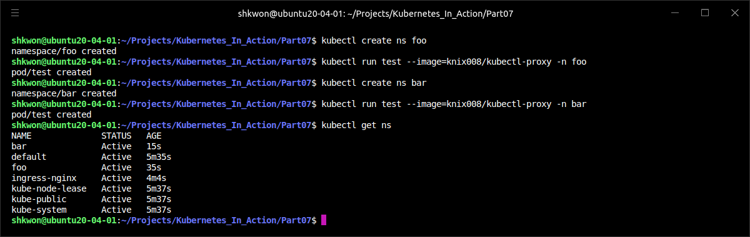
Securing the Cluster with Role-Based Access Control(RBAC)(8/46)
Introducing RBAC Resources :
  Before you can explore how RBAC resources affect what you can do through the API server, you need to make sure RBAC is enabled in your cluster. First, ensure you’re using at least version 1.6 of Kubernetes and that the RBAC plugin is the only configured authorization plugin. There can be multiple plugins enabled in parallel and if one of them allows an action to be performed, the action is allowed. The default Kubernetes API server mode supports “RBAC” now.(2023.01)
  Now, you’re going to create one pod in namespace “foo” and the other one in namespace “bar”, as shown in the following listing.
$ kubectl create ns foo
$ kubectl run test --image=knix008/kubectl-proxy -n foo
$ kubectl create ns bar
$ kubectl run test --image=knix008/kubectl-proxy -n bar

Slide 23
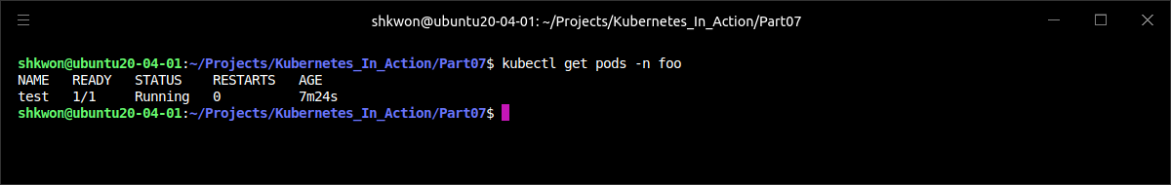

Securing the Cluster with Role-Based Access Control(RBAC)(9/46)
Introducing RBAC Resources :
  In the previous page, you ran a single container (based on the “kubectl-proxy” image) and will use “kubectl exec” to run “curl” inside that container directly. The proxy will take care of authentication and HTTPS, so you can focus on the authorization aspect of API server security.
  Now open two terminals and use “kubectl exec” to run a shell inside each of the two pods (one in each terminal). For example, to run the shell in the pod in namespace “foo”, first get the name of the pod :
$ kubectl get pods -n foo
$ kubectl get pods -n bar

Slide 24
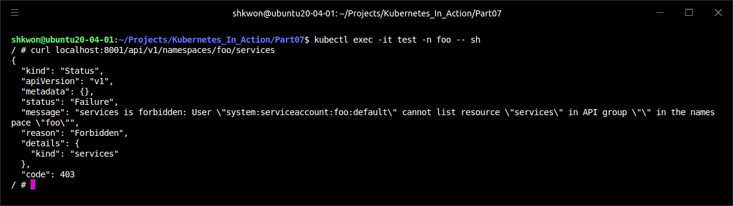
Securing the Cluster with Role-Based Access Control(RBAC)(10/46)
Introducing RBAC Resources :
  Then use the name in the “kubectl exec” command :
  To verify that RBAC is enabled and preventing the pod from reading cluster state, use “curl” to list Services in the “foo” namespace:
  NOTE : See the above screenshot for the result of the command. As you can see, RBAC is enabled and preventing the pod from reading the cluster state.
$ kubectl exec -it test -n foo -- sh
# curl localhost:8001/api/v1/namespaces/foo/services

Slide 25
Securing the Cluster with Role-Based Access Control(RBAC)(11/46)
Introducing RBAC Resources :
  You’re connecting to localhost:8001, which is where the kubectl proxy process is listening (as explained before). The process received your request and sent it to the API server while authenticating as the default ServiceAccount in the “foo” namespace (as evident from the API server’s response).
  The API server responded that the ServiceAccount isn’t allowed to list Services in the “foo” namespace, even though the pod is running in that same namespace. You’re seeing RBAC in action. The default permissions for a ServiceAccount don’t allow it to list or modify any resources. Now, let’s learn how to allow the ServiceAccount to do that. First, you’ll need to create a Role resource.

Slide 26
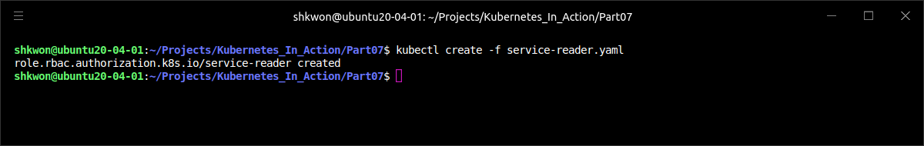
Securing the Cluster with Role-Based Access Control(RBAC)(12/46)
Using Roles and RoleBindings :
  A Role resource defines what actions can be taken on which resources (or, as explained earlier, which types of HTTP requests can be performed on which RESTful resources). The following listing defines a Role, which allows users to get and list Services in the “foo” namespace.
  NOTE : The plural form of “rules.resources” must be used when specifying resources.
apiVersion: rbac.authorization.k8s.io/v1
kind: Role
metadata:
namespace: foo
name: service-reader
rules:
- apiGroups: [""]
verbs: ["get", "list"]
resources: ["services"]
service-reader.yaml

Slide 27
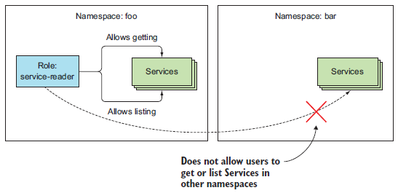
Securing the Cluster with Role-Based Access Control(RBAC)(13/46)
Using Roles and RoleBindings :
  The previous Role resource will be created in the “foo” namespace. Each resource type belongs to an API group, which you specify in the apiVersion field (along with the version) in the resource’s manifest. In a Role definition, you need to specify the apiGroup for the resources listed in each rule included in the definition. If you’re allowing access to resources belonging to different API groups, you use multiple rules.
  NOTE : In the previous example, you’re allowing access to all Service resources, but you could also limit access only to specific Service instances by specifying their names through an additional “resourceNames” field.
  The following figure shows the Role, its verbs and resources, and the namespace it will be created in.

Slide 28
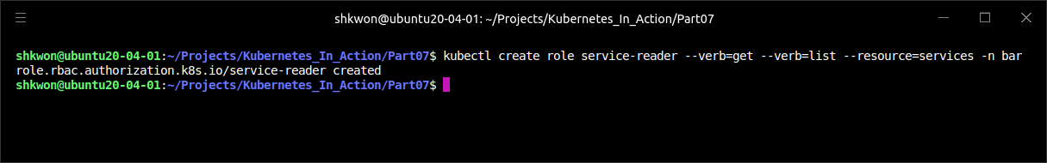
Securing the Cluster with Role-Based Access Control(RBAC)(14/46)
Using Roles and RoleBindings :
  Create the previous Role in the foo namespace now :
  NOTE : You can also use “$ kubectl create -f service-reader.yaml -n foo” command. Here, the “-n” option is shorthand for --namespace.
  NOTE : If you’re using GKE, the previous command may fail because you don’t have cluster-admin rights. To grant the rights, run the following command :
  Instead of creating the service-reader Role from a YAML file, you could also create it with the special “$ kubectl create role” command. Let’s use this method to create the Role in the bar namespace :
$ kubectl create -f service-reader.yaml
$ kubectl create clusterrolebinding cluster-admin-binding --clusterrole=cluster-admin --user=your.email@address.com
$ kubectl create role service-reader --verb=get --verb=list --resource=services -n bar

Slide 29
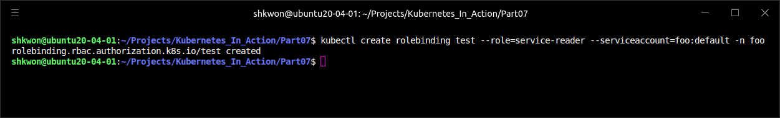
Securing the Cluster with Role-Based Access Control(RBAC)(15/46)
Using Roles and RoleBindings :
  The previous two Roles will allow you to list Services in the “foo” and “bar” namespaces from within your two pods (running in the foo and bar namespace, respectively). But creating the two Roles isn’t enough (you can check by executing the “curl” command again). You need to bind each of the Roles to the ServiceAccounts in their respective namespaces.
  A Role defines what actions can be performed, but it doesn’t specify who can perform them. To do that, you must bind the Role to a subject, which can be a user, a ServiceAccount, or a group (of users or ServiceAccounts). Binding Roles to subjects is achieved by creating a RoleBinding resource. To bind the Role to the default ServiceAccount, run the following command :
$ kubectl create rolebinding test --role=service-reader --serviceaccount=foo:default -n foo

Slide 30
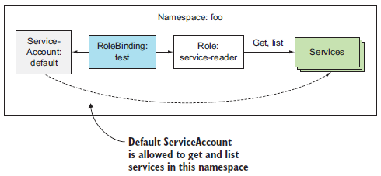
Securing the Cluster with Role-Based Access Control(RBAC)(16/46)
Using Roles and RoleBindings :
  You’re creating a RoleBinding, which binds the service-reader Role to the default ServiceAccount in namespace “foo”. You’re creating the RoleBinding in namespace “foo”. The RoleBinding and the referenced ServiceAccount and Role are shown in the following figure.
  NOTE : To bind a Role to a user instead of a ServiceAccount, use the “--user” argument to specify the username. To bind it to a group, use “--group”.

Slide 31
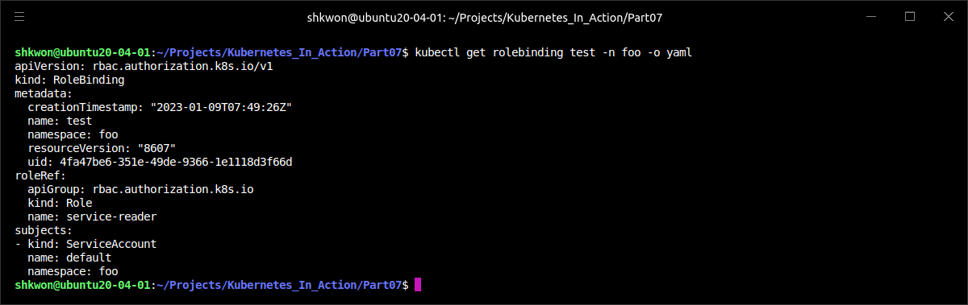
Securing the Cluster with Role-Based Access Control(RBAC)(17/46)
Using Roles and RoleBindings :
  The following listing shows the YAML of the RoleBinding you created.
  NOTE : As you can see, a RoleBinding always references a single Role (as evident from the “roleRef” property), but can bind the Role to multiple subjects (for example, one or more ServiceAccounts and any number of users or groups).
$ kubectl get rolebinding test -n foo -o yaml

Slide 32
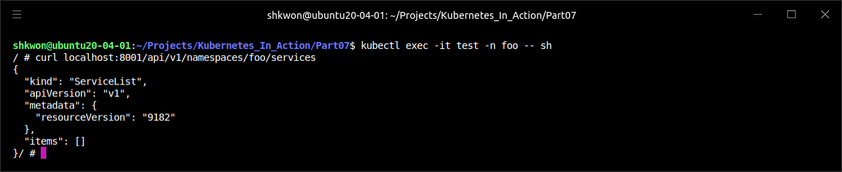
Securing the Cluster with Role-Based Access Control(RBAC)(18/46)
Using Roles and RoleBindings :
  Because the previous RoleBinding binds the Role to the ServiceAccount the pod in namespace “foo” is running under, you can now list Services from within that pod.
$ kubectl exec -it test -n foo -- sh
/ # curl localhost:8001/api/v1/namespaces/foo/services

Slide 33
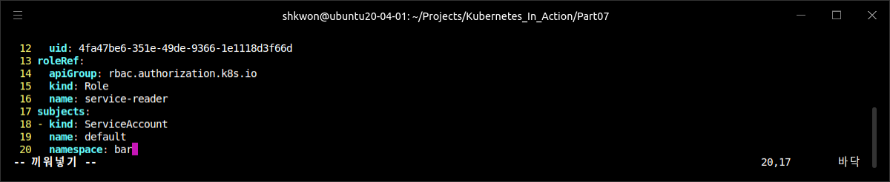
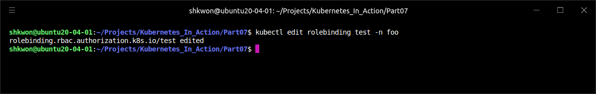
Securing the Cluster with Role-Based Access Control(RBAC)(19/46)
Using Roles and RoleBindings :
  The pod in namespace bar can’t list the Services in its own namespace, and obviously also not those in the foo namespace. But you can edit your RoleBinding in the “foo” namespace and add the other pod’s ServiceAccount, even though it’s in a different namespace.
  Run the following command :
$ kubectl edit rolebinding test -n foo

Slide 34
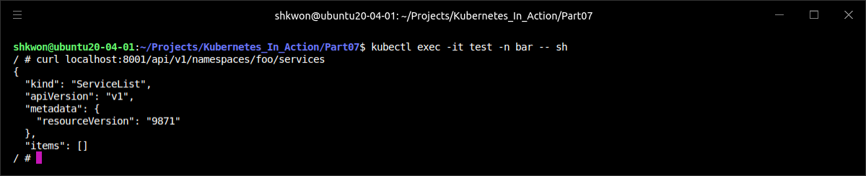
Securing the Cluster with Role-Based Access Control(RBAC)(20/46)
Using Roles and RoleBindings :
  Now you can also list Services in the “foo” namespace from inside the pod running in the “bar” namespace.
  Now, you have a RoleBinding in namespace “foo”, which references the service-reader Role (also in the “foo” namespace) and binds the default ServiceAccounts in both the “foo” and the “bar” namespaces, as depicted in the following figure.
WARNNING : Actually if you are not added the subject(meaning just changed the subject), then only ServiceAccounts in bar are allowed to get and list Services in the foo namespace.

Slide 35
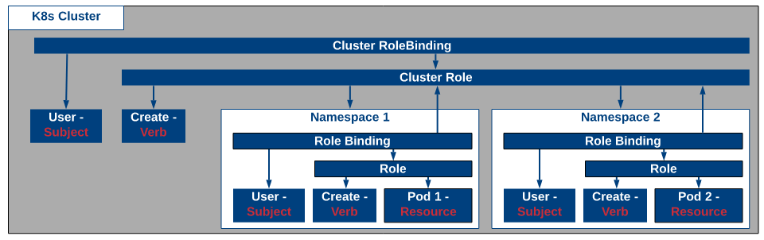
Securing the Cluster with Role-Based Access Control(RBAC)(21/46)
Using ClusterRoles and ClusterRoleBindings :
  Roles and RoleBindings are namespaced resources, meaning they reside in and apply to resources in a single namespace, but, as we saw, RoleBindings can refer to ServiceAccounts from other namespaces, too.
  In addition to these namespaced resources, two cluster-level RBAC resources also exist: ClusterRole and ClusterRoleBinding. They’re not namespaced.
  A regular Role only allows access to resources in the same namespace the Role is in. If you want to allow someone access to resources across different namespaces, you have to create a Role and RoleBinding in every one of those namespaces. If you want to extend this to all namespaces (this is something a cluster administrator would probably need), you need to create the same Role and RoleBinding in each namespace. When creating an additional namespace, you have to remember to create the two resources there as well.
  Certain resources aren’t namespaced at all (this includes Nodes, PersistentVolumes, Namespaces, and so on). We’ve also mentioned the API server exposes some URL paths that don’t represent resources (“/healthz” for example). Regular Roles can’t grant access to those resources or non-resource URLs, but ClusterRoles can.
  A ClusterRole is a cluster-level resource for allowing access to non-namespaced resources or non-resource URLs or used as a common role to be bound inside individual namespaces, saving you from having to redefine the same role in each of them.

Slide 36
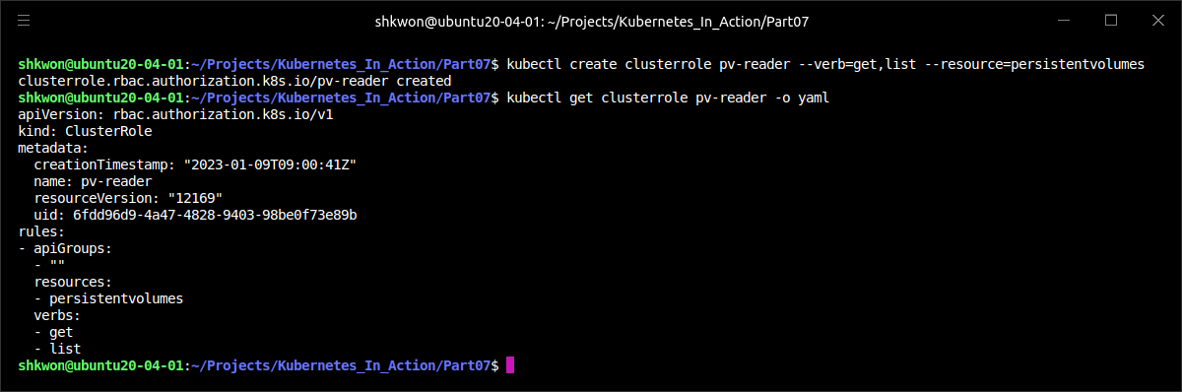
Securing the Cluster with Role-Based Access Control(RBAC)(22/46)
Using ClusterRoles and ClusterRoleBindings :
  A ClusterRole can be used to allow access to cluster-level resources. Let’s look at how to allow your pod to list PersistentVolumes in your cluster. First, you’ll create a ClusterRole called “pv-reader” :
$ kubectl create clusterrole pv-reader --verb=get,list --resource=persistentvolumes

Slide 37
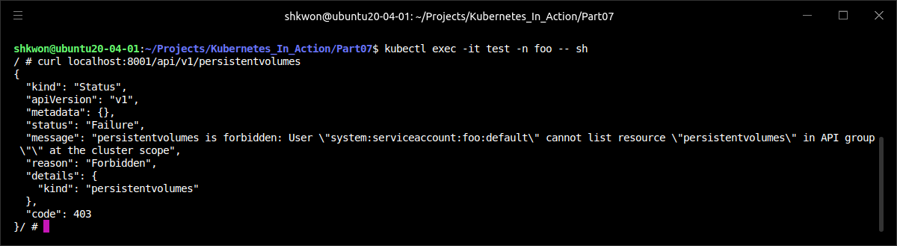
Securing the Cluster with Role-Based Access Control(RBAC)(23/46)
Using ClusterRoles and ClusterRoleBindings :
  Before you bind this ClusterRole to your pod’s ServiceAccount, verify whether the pod can list PersistentVolumes. Run the following command in the first terminal, where you’re running the shell inside the pod in the “foo” namespace :
  NOTE : The URL contains no namespace, because PersistentVolumes aren’t namespaced.
$ kubectl exec -it test -n foo -- sh
/ # curl localhost:8001/api/v1/persistentvolumes

Slide 38
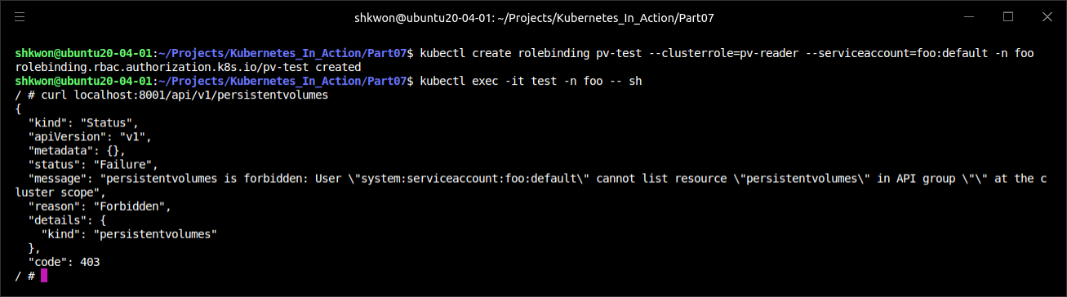
Securing the Cluster with Role-Based Access Control(RBAC)(24/46)
Using ClusterRoles and ClusterRoleBindings :
  As expected, the default ServiceAccount can’t list PersistentVolumes. You need to bind the ClusterRole to your ServiceAccount to allow it to do that. ClusterRoles can be bound to subjects with regular RoleBindings, so you’ll create a RoleBinding now :
  NOTE : From the result of the above screenshot, we still cannot list the persistentvolumes resouces.
$ kubectl create rolebinding pv-test --clusterrole=pv-reader --serviceaccount=foo:default -n foo

Slide 39
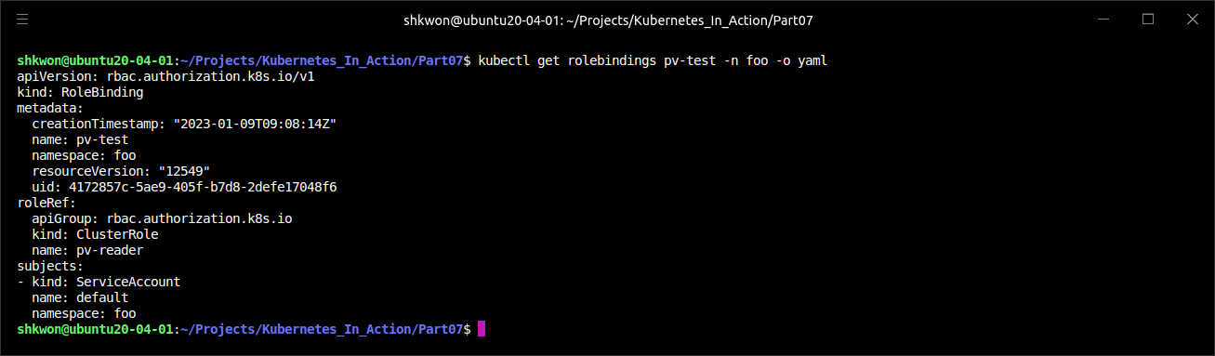
Securing the Cluster with Role-Based Access Control(RBAC)(25/46)
Using ClusterRoles and ClusterRoleBindings :
  Let’s examine the RoleBinding’s YAML in the following listing. Can you tell what (if anything) is wrong with it?
  NOTE : The YAML looks perfectly fine. You’re referencing the correct ClusterRole and the correct ServiceAccount.
$ kubectl get rolebindings pv-test -n foo -o yaml

Slide 40
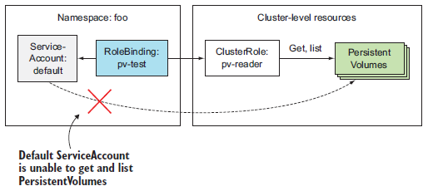
Securing the Cluster with Role-Based Access Control(RBAC)(26/46)
Using ClusterRoles and ClusterRoleBindings :
  Although you can create a RoleBinding and have it reference a ClusterRole when you want to enable access to namespaced resources, you can’t use the same approach for cluster-level (non-namespaced) resources. To grant access to cluster-level resources, you must always use a ClusterRoleBinding.

Slide 41
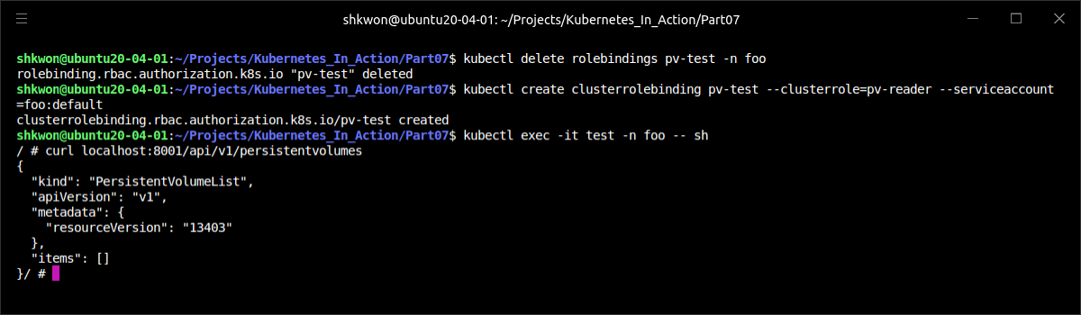
Securing the Cluster with Role-Based Access Control(RBAC)(27/46)
Using ClusterRoles and ClusterRoleBindings :
  Creating a ClusterRoleBinding isn’t that different from creating a RoleBinding, but you’ll clean up and delete the RoleBinding first :
  NOTE : You need to specify to delete the RoleBindings with “-n foo” option. But, you don’t need to specify the name space in creating a ClusterRoleBinding.
$ kubectl delete rolebinding pv-test -n foo
$ kubectl create clusterrolebinding pv-test --clusterrole=pv-reader --serviceaccount=foo:default
$ kubectl exec -it test -n foo -- sh
/ # curl localhost:8001/api/v1/persistentvolumes

Slide 42
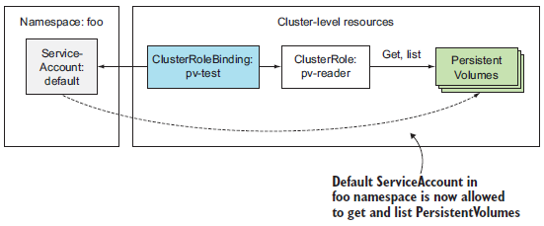
Securing the Cluster with Role-Based Access Control(RBAC)(28/46)
Using ClusterRoles and ClusterRoleBindings :
  NOTICE : You must use a ClusterRole and a ClusterRoleBinding when granting access to cluster-level resources.
  NOTE : Remember that a RoleBinding can’t grant access to cluster-level resources, even if it references a ClusterRoleBinding.

Slide 43
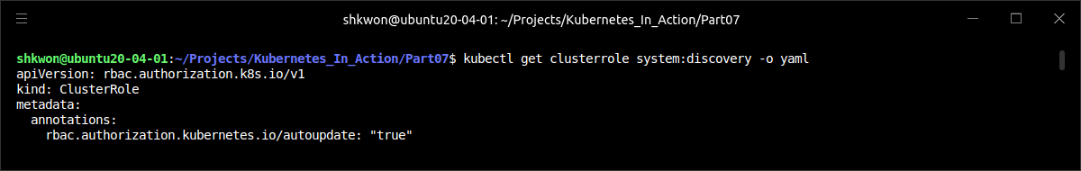
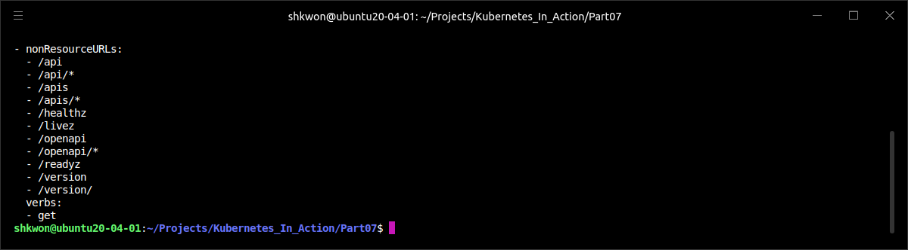
Securing the Cluster with Role-Based Access Control(RBAC)(29/46)
Using ClusterRoles and ClusterRoleBindings :
  We’ve mentioned that the API server also exposes non-resource URLs. Access to these URLs must also be granted explicitly; otherwise the API server will reject the client’s request. Usually, this is done for you automatically through the “system:discovery” ClusterRole and the identically named ClusterRoleBinding, which appear among other predefined ClusterRoles and ClusterRoleBindings.
  Let’s inspect the “system:discovery” ClusterRole shown in the following listing..
$ kubectl get clusterrole system:discovery -o yaml

Slide 44
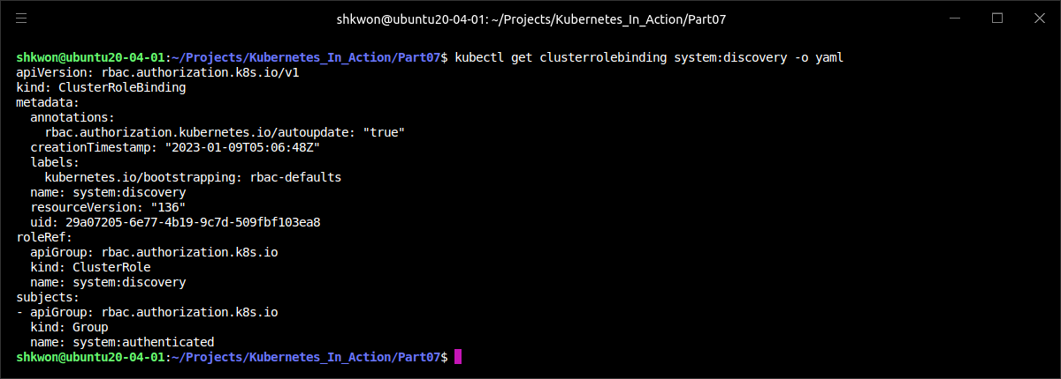
Securing the Cluster with Role-Based Access Control(RBAC)(30/46)
Using ClusterRoles and ClusterRoleBindings :
  You can see this ClusterRole refers to URLs instead of resources (field “nonResourceURLs” is used instead of the resources field). The verbs field only allows the GET HTTP method to be used on these URLs.
  NOTE : For non-resource URLs, plain HTTP verbs such as post, put, and patch are used instead of create or update. The verbs need to be specified in lowercase.
  As with cluster-level resources, ClusterRoles for non-resource URLs must be bound with a ClusterRoleBinding. Binding them with a RoleBinding won’t have any effect. The “system:discovery” ClusterRole has a corresponding “system:discovery” ClusterRoleBinding.
$ kubectl get clusterrolebinding system:discovery -o yaml

Slide 45
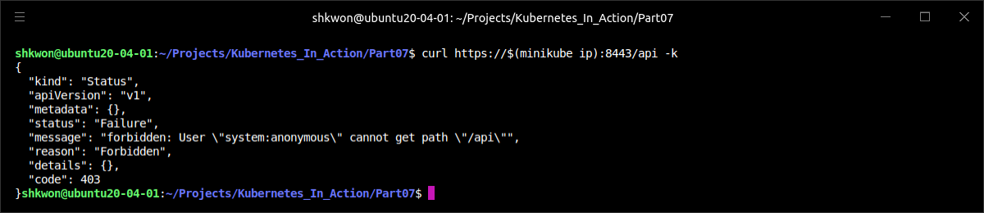
Securing the Cluster with Role-Based Access Control(RBAC)(31/46)
Using ClusterRoles and ClusterRoleBindings :
  The YAML in the previous example shows the ClusterRoleBinding refers to the system:discovery ClusterRole, as expected. It’s bound to one group, system:authenticated(there is a “system:unauthenticated” also), which makes it bound to all authenticated users. This means only authenticated users can access the URLs listed in the ClusterRole.
  NOTE : Groups are in the domain of the authentication plugin. When a request is received by the API server, it calls the authentication plugin to obtain the list of groups the user belongs to. This information is then used in authorization.
  You can confirm this by accessing the “/api” URL path from inside the pod (through the “kubectl proxy”, which means you’ll be authenticated as the pod’s ServiceAccount) and from your local machine, without specifying any authentication tokens (making you an unauthenticated user).
  NOTE : The above screenshot shows that you are an unauthenticated user.
$ curl https://$(minikube ip):8443/api -k

Slide 46
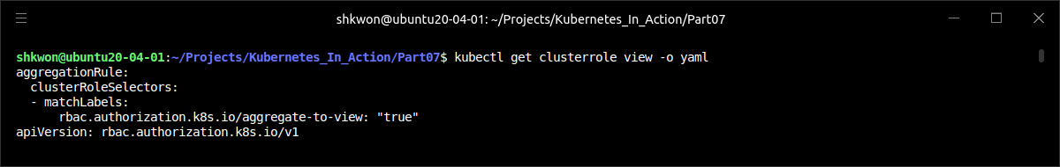
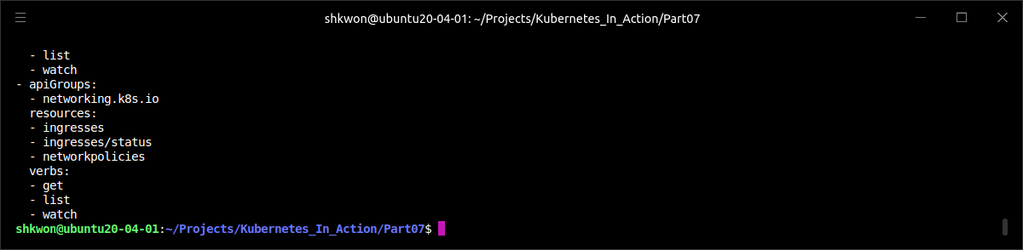
Securing the Cluster with Role-Based Access Control(RBAC)(32/46)
Using ClusterRoles and ClusterRoleBindings :
  ClusterRoles don’t always need to be bound with cluster-level ClusterRoleBindings. They can also be bound with regular, namespaced RoleBindings. You’ve already started looking at predefined ClusterRoles, so let’s look at another one called “view”, which is shown in the following listing.
$ kubectl get clusterrole view -o yaml

Slide 47
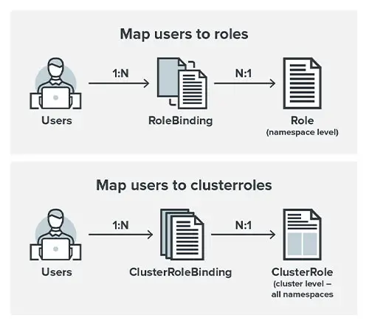
Securing the Cluster with Role-Based Access Control(RBAC)(33/46)
Using ClusterRoles and ClusterRoleBindings :
  From the previous example, the ClusterRole has many rules. The rule allows getting, listing, and watching resources like ConfigMaps, Endpoints, PersistentVolumeClaims, and so on. These are namespaced resources, even though you’re looking at a ClusterRole (not a regular, namespaced Role). What exactly does this ClusterRole do?
  It depends whether it’s bound with a ClusterRoleBinding or a RoleBinding (it can be bound with either). If you create a ClusterRoleBinding and reference the ClusterRole in it, the subjects listed in the binding can view the specified resources across all namespaces. If, on the other hand, you create a RoleBinding, the subjects listed in the binding can only view resources in the namespace of the RoleBinding. You’ll try both options now.

Slide 48
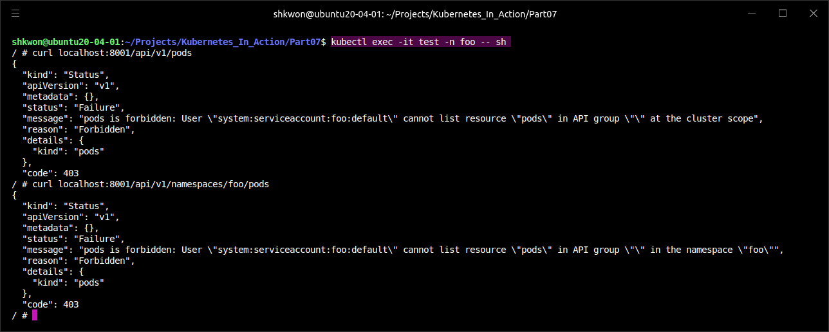
Securing the Cluster with Role-Based Access Control(RBAC)(34/46)
Using ClusterRoles and ClusterRoleBindings :
  You’ll see how the two options affect your test pod’s ability to list pods. First, let’s see what happens before any bindings are in place :
$ kubectl exec -it test -n foo -- sh
$ curl localhost:8001/api/v1/pods
$ curl localhost:8001/api/v1/namespaces/foo/pods

Slide 49
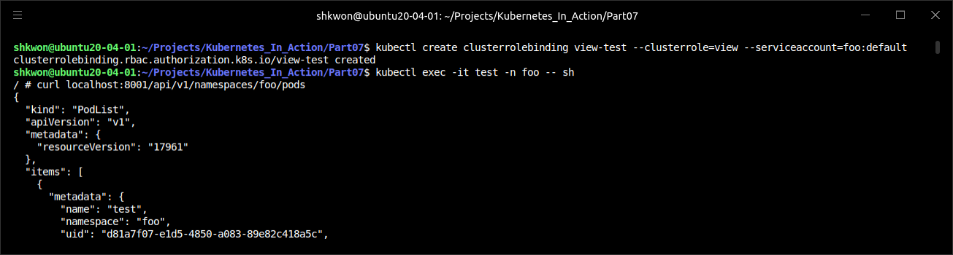
Securing the Cluster with Role-Based Access Control(RBAC)(35/46)
Using ClusterRoles and ClusterRoleBindings :
  With the first command, you’re trying to list pods across all namespaces. With the second, you’re trying to list pods in the foo namespace. The server doesn’t allow you to do either.
  Let’s see what happens when you create a ClusterRoleBinding and bind it to the pod’s ServiceAccount :
$ kubectl create clusterrolebinding view-test --clusterrole=view --serviceaccount=foo:default

Slide 50
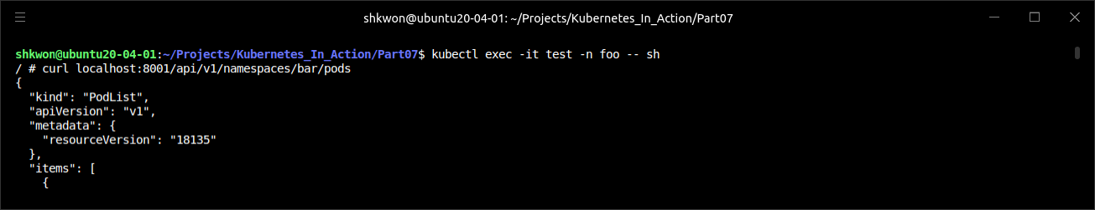
Securing the Cluster with Role-Based Access Control(RBAC)(36/46)
Using ClusterRoles and ClusterRoleBindings :
  Because you created a ClusterRoleBinding, it applies across all namespaces. The pod in namespace “foo” can list pods in the “bar” namespace as well :
  NOTE : The pod is allowed to list pods in a different namespace. It can also retrieve pods across all namespaces by hitting the “/api/v1/pods” URL path.
$ kubectl exec -it test -n foo -- sh
$ curl localhost:8001/api/v1/namespaces/bar/pods
$ curl localhost:8001/api/v1/pods

Slide 51
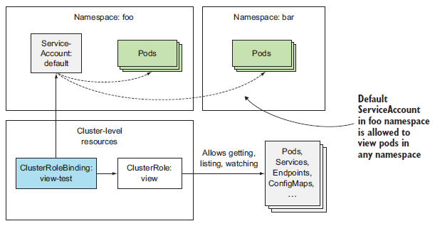
Securing the Cluster with Role-Based Access Control(RBAC)(37/46)
Using ClusterRoles and ClusterRoleBindings :
  To summarize, combining a ClusterRoleBinding with a ClusterRole referring to namespaced resources allows the pod to access namespaced resources in any namespace, as shown in the following figure.

Slide 52
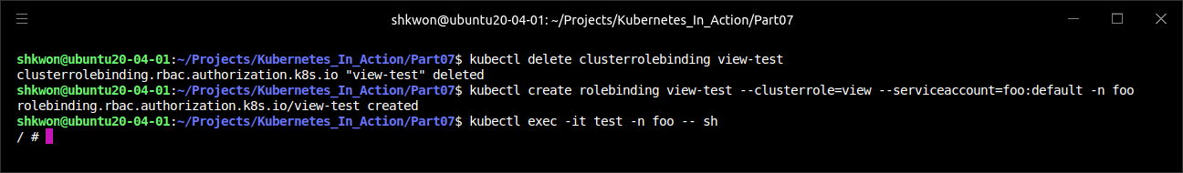
Securing the Cluster with Role-Based Access Control(RBAC)(38/46)
Using ClusterRoles and ClusterRoleBindings :
  Now, let’s see what happens if you replace the ClusterRoleBinding with a RoleBinding. First, delete the ClusterRoleBinding.
  Next create a RoleBinding instead. Because a RoleBinding is namespaced, you need to specify the namespace you want to create it in. Create it in the “foo” namespace :
  You now have a RoleBinding in the “foo” namespace, binding the default ServiceAccount in that same namespace with the view ClusterRole.
$ kubectl delete clusterrolebinding view-test
$ kubectl create rolebinding view-test --clusterrole=view --serviceaccount=foo:default -n foo
$ kubectl exec -it test -n foo -- sh

Slide 53
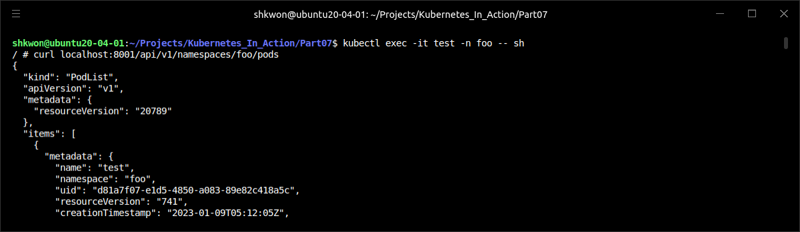
Securing the Cluster with Role-Based Access Control(RBAC)(39/46)
Using ClusterRoles and ClusterRoleBindings :
  What can your pod access now? See the following screenshot.
/ # curl localhost:8001/api/v1/namespaces/foo/pods
/ # curl localhost:8001/api/v1/namespaces/bar/pods
/ # curl localhost:8001/api/v1/pods

Slide 54
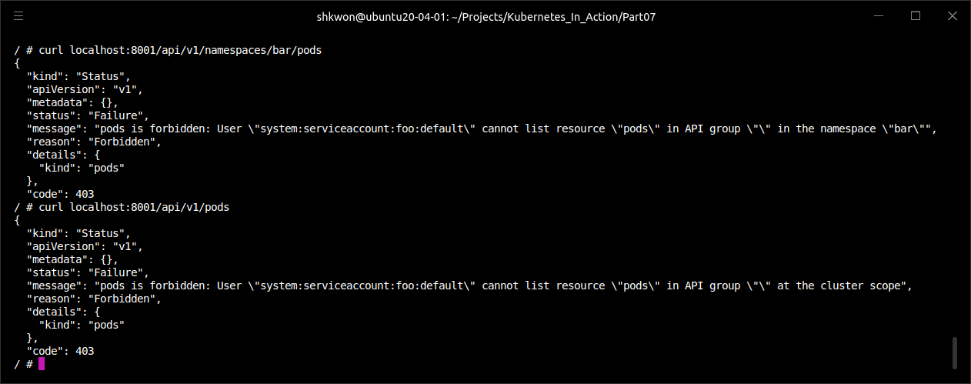
Securing the Cluster with Role-Based Access Control(RBAC)(40/46)
Using ClusterRoles and ClusterRoleBindings :
  As you can see in the previous and the following screenshot, your pod can list pods in the foo namespace, but not in any other specific namespace or across all namespaces.

Slide 55

Securing the Cluster with Role-Based Access Control(RBAC)(41/46)
Using ClusterRoles and ClusterRoleBindings :
  The following figure shows that you can list the pods in the “foo” namespace and you cannot list the pods in the “bar” namespace because of the RoleBinding.

Slide 56

Securing the Cluster with Role-Based Access Control(RBAC)(42/46)
Using ClusterRoles and ClusterRoleBindings :
  Let’s see if we can make sense of all these combinations by categorizing them per specific use case. Refer to the following table.

Slide 57


Securing the Cluster with Role-Based Access Control(RBAC)(43/46)
Understanding Default ClusterRoles and ClusterRoleBindings :
  Kubernetes comes with a default set of ClusterRoles and ClusterRoleBindings, which are updated every time the API server starts. This ensures all the default roles and bindings are recreated if you mistakenly delete them or if a newer version of Kubernetes uses a different configuration of cluster roles and bindings.
  You can see the default cluster roles and bindings in the following listing.
$ kubectl get clusterrolebindings
$ kubectl get clusterroles

Slide 58
Securing the Cluster with Role-Based Access Control(RBAC)(44/46)
Understanding Default ClusterRoles and ClusterRoleBindings :
  The most important roles are the view, edit, admin, and cluster-admin ClusterRoles. They’re meant to be bound to ServiceAccounts used by user-defined pods.
  You already used the default view ClusterRole in the previous example. It allows reading most resources in a namespace, except for Roles, RoleBindings, and Secrets. You’re probably wondering, why not Secrets? Because one of those Secrets might include an authentication token with greater privileges than those defined in the view ClusterRole and could allow the user to masquerade as a different user to gain additional privileges (privilege escalation).
  Next is the edit ClusterRole, which allows you to modify resources in a namespace, but also allows both reading and modifying Secrets. It doesn’t, however, allow viewing or modifying Roles or RoleBindings—again, this is to prevent privilege escalation.
  Complete control of the resources in a namespace is granted in the admin ClusterRole. Subjects with this ClusterRole can read and modify any resource in the namespace, except ResourceQuotas and the Namespace resource itself. The main difference between the edit and the admin ClusterRoles is in the ability to view and modify Roles and RoleBindings in the namespace.
  NOTE : To prevent privilege escalation, the API server only allows users to create and update Roles if they already have all the permissions listed in that Role (and for the same scope).

Slide 59
Securing the Cluster with Role-Based Access Control(RBAC)(45/46)
Understanding Default ClusterRoles and ClusterRoleBindings :
  Complete control of the Kubernetes cluster can be given by assigning the cluster-admin ClusterRole to a subject. The admin ClusterRole doesn’t allow users to modify the namespace’s ResourceQuota objects or the Namespace resource itself. If you want to allow a user to do that, you need to create a RoleBinding that references the cluster-admin ClusterRole. This gives the user included in the RoleBinding complete control over all aspects of the namespace in which the RoleBinding is created.
  If you’ve paid attention, you probably already know how to give users complete control of all the namespaces in the cluster. By referencing the cluster-admin ClusterRole in a ClusterRoleBinding instead of a RoleBinding.
  The list of default ClusterRoles includes a large number of other ClusterRoles, which start with the “system:” prefix. These are meant to be used by the various Kubernetes components. Among them, you’ll find roles such as “system:kube-scheduler”, which is obviously used by the Scheduler, “system:node”, which is used by the Kubelets, and so on.
  Although the Controller Manager runs as a single pod, each controller running inside it can use a separate ClusterRole and ClusterRoleBinding (they’re prefixed with “system:controller:”).
  Each of these system ClusterRoles has a matching ClusterRoleBinding, which binds it to the user the system component authenticates as. The “system:kube-scheduler” ClusterRoleBinding, for example, assigns the identically named ClusterRole to the “system:kube-scheduler” user, which is the username the scheduler Authenticates as.

Slide 60

Securing the Cluster with Role-Based Access Control(RBAC)(46/46)
Granting Authorization Permissions Wisely :
  By default, the default ServiceAccount in a namespace has no permissions other than those of an unauthenticated user (as you may remember from one of the previous examples, the “system:discovery” ClusterRole and associated binding allow anyone to make GET requests on a few non-resource URLs). Therefore, pods, by default, can’t even view cluster state. It’s up to you to grant them appropriate permissions to do that.
  Obviously, giving all your ServiceAccounts the cluster-admin ClusterRole is a bad idea. As is always the case with security, it’s best to give everyone only the permissions they need to do their job and not a single permission more (principle of least privilege).
  It’s a good idea to create a specific ServiceAccount for each pod (or a set of pod replicas) and then associate it with a tailor-made Role (or a ClusterRole) through a RoleBinding (not a ClusterRoleBinding, because that would give the pod access to resources in other namespaces, which is probably not what you want).
  If one of your pods (the application running within it) only needs to read pods, while the other also needs to modify them, then create two different ServiceAccounts and make those pods use them by specifying the serviceAccountName property in the pod spec. Don’t add all the necessary permissions required by both pods to the default ServiceAccount in the namespace.
  Your aim is to reduce the possibility of an intruder getting hold of your cluster. Today’s complex apps contain many vulnerabilities. You should expect unwanted persons to eventually get their hands on the ServiceAccount’s authentication token, so you should always constrain the ServiceAccount to prevent them from doing any real damage.

Slide 61
Securing Cluster
Custer Nodes and The Network Security

Slide 62

Using the Host Node’s Namespaces in a Pod(1/9)
The Separated Namespaces :
  Containers in a pod usually run under separate Linux namespaces, which isolate their processes from processes running in other containers or in the node’s default namespaces.
  For example, each pod gets its own IP and port space, because it uses its own network namespace. Likewise, each pod has its own process tree, because it has its own PID(Process ID) namespace, and it also uses its own IPC namespace, allowing only processes in the same pod to communicate with each other through the Inter-Process Communication mechanism (IPC).

Slide 63

Using the Host Node’s Namespaces in a Pod(2/9)
Using the Node’s Network Namespace in a Pod :
  Certain pods (usually system pods) need to operate in the host’s default namespaces, allowing them to see and manipulate node-level resources and devices. For example, a pod may need to use the node’s network adapters instead of its own virtual network adapters. This can be achieved by setting the “hostNetwork” property in the pod spec to “true”.
  In that case, the pod gets to use the node’s network interfaces instead of having its own set, as shown in the following figure. This means the pod doesn’t get its own IP address and if it runs a process that binds to a port, the process will be bound to the node’s port.

Slide 64

Using the Host Node’s Namespaces in a Pod(3/9)
Using the Node’s Network Namespace in a Pod :
  You can try running such a pod. The next listing shows an example pod manifest.
apiVersion: v1
kind: Pod
metadata:
name: pod-with-host-network
spec:
hostNetwork: true
containers:
- name: main
image: alpine
command: ["/bin/sleep", "999999"]
pod-with-host-network.yaml

Slide 65

Using the Host Node’s Namespaces in a Pod(4/9)
Using the Node’s Network Namespace in a Pod :
  After you run the pod, you can use the following command to see that it’s indeed using the host’s network namespace (it sees all the host’s network adapters, for example).
  When the Kubernetes Control Plane components are deployed as pods (such as when you deploy your cluster with kubeadm), you’ll find that those pods use the “hostNetwork“ option, effectively making them behave as if they weren’t running inside a pod.
$ kubectl exec pod-with-host-network -- ifconfig

Slide 66

Using the Host Node’s Namespaces in a Pod(5/9)
Binding to a Host Port without Using the Host’s Network Namespace :
  A related feature allows pods to bind to a port in the node’s default namespace, but still have their own network namespace. This is done by using the “hostPort” property in one of the container’s ports defined in the “spec.containers.ports” field.
  Don’t confuse pods using “hostPort” with pods exposed through a “NodePort” service. They’re two different things, as explained in the following figure.
  When a pod is using a hostPort, a connection to the node’s port is forwarded directly to the pod running on that node, whereas with a NodePort service, a connection to the node’s port is forwarded to a randomly selected pod (possibly on another node). The other difference is that with pods using a hostPort, the node’s port is only bound on nodes that run such pods, whereas NodePort services bind the port on all nodes, even on those that don’t run such a pod (as on node 3 in the figure).

Slide 67

Using the Host Node’s Namespaces in a Pod(6/9)
Binding to a Host Port without Using the Host’s Network Namespace :
  It’s important to understand that if a pod is using a specific host port, only one instance of the pod can be scheduled to each node, because two processes can’t bind to the same host port. The Scheduler takes this into account when scheduling pods, so it doesn’t schedule multiple pods to the same node, as shown in the following figure. If you have three nodes and want to deploy four pod replicas, only three will be scheduled (one pod will remain Pending).

Slide 68
Using the Host Node’s Namespaces in a Pod(7/9)
Binding to a Host Port without Using the Host’s Network Namespace :
  Let’s see how to define the “hostPort“ in a pod’s YAML definition. The following listing shows the YAML to run your “kubia” pod and bind it to the node’s port 9000.
  After you create this pod, you can access it through port 9000 of the node it’s scheduled to. If you have multiple nodes, you’ll see you can’t access the pod through that port on the other nodes.
  NOTE : If you’re trying this on GKE, you need to configure the firewall properly using “gcloud compute firewall-rules”.
  The “hostPort” feature is primarily used for exposing system services, which are deployed to every node using DaemonSets. Initially, people also used it to ensure two replicas of the same pod were never scheduled to the same node, but now you have a better way of achieving this.
apiVersion: v1
kind: Pod
metadata:
name: kubia-hostport
spec:
containers:
- image: knix008/kubia
name: kubia
ports:
- containerPort: 8080
hostPort: 9000
protocol: TCP
kubia-hostport.yaml

Slide 69

NOTE : Using hostPort
Creating the Pod :
  You can create a pod using the previously defined YAML file. Run the following command.
$ kubectl create -f kubia-hostport.yaml

Slide 70

Using the Host Node’s Namespaces in a Pod(8/9)
Using the Node’s PID and IPC Namespaces :
  Similar to the “hostNetwork” option are the “hostPID” and “hostIPC” pod spec properties. When you set them to true, the pod’s containers will use the node’s PID and IPC namespaces, allowing processes running in the containers to see all the other processes on the node or communicate with them through IPC, respectively. See the following listing for an example.
apiVersion: v1
kind: Pod
metadata:
name: pod-with-host-pid-and-ipc
spec:
hostPID: true
hostIPC: true
containers:
- name: main
image: alpine
command: ["/bin/sleep", "999999"]
pod-with-host-pid-and-ipc.yaml

Slide 71

Using the Host Node’s Namespaces in a Pod(9/9)
Using the Node’s PID and IPC Namespaces :
  Pods usually see only their own processes, but if you run this pod and then list the processes from within its container, you’ll see all the processes running on the host node, not only the ones running in the container, as shown in the following listing.
  By setting the “hostIPC” property to true, processes in the pod’s containers can also communicate with all the other processes running on the node, through Inter-Process Communication(IPC).
$ kubectl exec pod-with-host-pid-and-ipc -- ps aux

Slide 72

Configuring the Container’s Security Context(1/19)
Security Context :
  Besides allowing the pod to use the host’s Linux namespaces, other security-related features can also be configured on the pod and its container through the “securityContext” properties, which can be specified under the pod spec directly and inside the spec of individual containers.
  Configuring the security context allows you to do various things :
    Specify the user (the user’s ID) under which the process in the container will run.
    Prevent the container from running as root (the default user a container runs as is usually defined in the container image itself, so you may want to prevent containers from running as root).
    Run the container in privileged mode, giving it full access to the node’s kernel.
    Configure fine-grained privileges, by adding or dropping capabilities—in contrast to giving the container all possible permissions by running it in privileged mode.
    Set SELinux(Security Enhanced Linux) options to strongly lock down a container.
    Prevent the process from writing to the container’s filesystem.

Slide 73

Configuring the Container’s Security Context(2/19)
Security Context :
  First, run a pod with the default security context options (by not specifying them at all), so you can see how it behaves compared to pods with a custom security context :
  Let’s see what user and group ID the container is running as, and which groups it belongs to. You can see this by running the “id” command inside the container.
  The container is running as “user ID (uid) 0”, which is “root”, and “group ID (gid) 0” (also “root”). It’s also a member of multiple other groups.
  NOTE : What user the container runs as is specified in the container image. In a Dockerfile, this is done using the “USER” directive. If omitted, the container runs as root.
$ kubectl run pod-with-defaults --image alpine --restart Never -- /bin/sleep 999999
$ kubectl exec pod-with-defaults -- id

Slide 74

Configuring the Container’s Security Context(3/19)
Running a Container as a Specific User :
  To run a pod under a different user ID than the one that’s baked into the container image, you’ll need to set the pod’s “securityContext.runAsUser” property. You’ll make the container run as user “guest”, whose “user ID” in the “alpine” container image is “405”, as shown in the following listing.
  Now, to see the effect of the “runAsUser” property, run the “id” command in this new pod, the way you did before :
apiVersion: v1
kind: Pod
metadata:
name: pod-as-user-guest
spec:
containers:
- name: main
image: alpine
command: ["/bin/sleep", "999999"]
securityContext:
runAsUser: 405
pod-as-user-guest.yaml

Slide 75
Configuring the Container’s Security Context(4/19)
Preventing a Container from Running as Root :
  Imagine having a pod deployed with a container image that was built with a “USER” daemon directive in the Dockerfile, which makes the container run under the daemon user. What if an attacker gets access to your image registry and pushes a different image under the same tag? The attacker’s image is configured to run as the root user. When Kubernetes schedules a new instance of your pod, the Kubelet will download the attacker’s image and run whatever code they put into it.
  Although containers are mostly isolated from the host system, running their processes as root is still considered a bad practice. For example, when a host directory is mounted into the container, if the process running in the container is running as root, it has full access to the mounted directory, whereas if it’s running as non-root, it won’t.
  To prevent the attack scenario described previously, you can specify that the pod’s container needs to run as a non-root user, as shown in the following listing.
apiVersion: v1
kind: Pod
metadata:
name: pod-run-as-non-root
spec:
containers:
- name: main
image: alpine
command: ["/bin/sleep", "999999"]
securityContext:
runAsNonRoot: true
pod-run-as-non-root.yaml

Slide 76

Configuring the Container’s Security Context(5/19)
Preventing a Container from Running as Root :
  If you deploy this pod, it gets scheduled, but is not allowed to run :
  NOTE : Now, if anyone tampers with your container images, they won’t get far.
$ kubectl create -f pod-run-as-non-root.yaml
$ kubectl get pod pod-run-as-non-root

Slide 77


NOTE : Checking the Log and Status of a Pod
Pod Information :
  As you learned before, you can use “$ kubectl describe pod” command to see the detailed information about a pod you want to know the reason of failure. See the following screenshot, which shows the reason of the failure of creating pod.

Slide 78
Configuring the Container’s Security Context(6/19)
Running Pods in Privileged Mode :
  Sometimes pods need to do everything that the node they’re running on can do, such as use protected system devices or other kernel features, which aren’t accessible to regular containers.
  An example of such a pod is the “kube-proxy” pod, which needs to modify the node’s iptables rules to make services work. If you deploy a cluster with “kubeadm”, you’ll see every cluster node runs a “kube-proxy” pod and you can examine its YAML specification to see all the special features it’s using.
  To get full access to the node’s kernel, the pod’s container runs in privileged mode. This is achieved by setting the privileged property in the container’s “securityContext” property to “true”. You’ll create a privileged pod from the YAML in the following listing.
apiVersion: v1
kind: Pod
metadata:
name: pod-privileged
spec:
containers:
- name: main
image: alpine
command: ["/bin/sleep", "999999"]
securityContext:
privileged: true
pod-privileged.yaml

Slide 79

Configuring the Container’s Security Context(7/19)
Running Pods in Privileged Mode :
  Linux has a special file directory called “/dev”, which contains device files for all the devices on the system. These aren’t regular files on disk, but are special files used to communicate with devices. Let’s see what devices are visible in the non-privileged container you deployed earlier (the “pod-with-default” pod), by listing files in its “/dev” directory, as shown in the following listing. The privileged container sees all the host node’s devices and it can use any device freely.
$ kubectl create -f pod-privileged.yaml
$ kubectl exec -it pod-with-default -- ls /dev
$ kubectl exec -it pod-privileged -- ls /dev

Slide 80

Configuring the Container’s Security Context(8/19)
Adding Individual Kernel Capabilities to a Container :
  In the old days, traditional UNIX implementations only distinguished between privileged and unprivileged processes, but for many years, Linux has supported a much more fine-grained permission system through kernel capabilities.
  Instead of making a container privileged and giving it unlimited permissions, a much safer method (from a security perspective) is to give it access only to the kernel features it really requires. Kubernetes allows you to add capabilities to each container or drop part of them, which allows you to fine-tune the container’s permissions and limit the impact of a potential intrusion by an attacker.
  For example, a container usually isn’t allowed to change the system time (the hardware clock’s time). You can confirm this by trying to set the time in your “pod-with-default” pod :
$ kubectl exec -it pod-with-default -- date +%T -s "12:00:00"

Slide 81
Configuring the Container’s Security Context(9/19)
Adding Individual Kernel Capabilities to a Container :
  If you want to allow the container to change the system time, you can add a capability called “CAP_SYS_TIME” to the container’s capabilities list, as shown in the following listing.
  NOTE : Linux kernel capabilities are usually prefixed with “CAP_”. But when specifying them in a pod spec, you must leave out the prefix.
apiVersion: v1
kind: Pod
metadata:
name: pod-add-settime-capability
spec:
containers:
- name: main
image: alpine
command: ["/bin/sleep", "999999"]
securityContext:
capabilities:
add:
- SYS_TIME
pod-add-settime-capability.yaml

Slide 82

Configuring the Container’s Security Context(10/19)
Adding Individual Kernel Capabilities to a Container :
  If you run the same command in this new pod’s container, the system time is changed successfully :
  WARNING : If you try this yourself, be aware that it may cause your worker node to become unusable. In Minikube, although the system time was automatically reset back by the Network Time Protocol (NTP) daemon, I had to reboot the VM to schedule new pods.
  Adding capabilities like this is a much better way than giving a container full privileges with “privileged: true”. Admittedly, it does require you to know and understand what each capability does.
  TIP : You’ll find the list of Linux kernel capabilities in the Linux man pages.
$ kubectl create -f pod-add-settime-capability.yaml
$ kubectl exec -it pod-add-settime-capability -- date +%T -s "12:00:00"
$ kubectl exec -it pod-add-settime-capability -- date

Slide 83

Configuring the Container’s Security Context(11/19)
Dropping Capabilities from a Container :
  You’ve seen how to add capabilities, but you can also drop capabilities that may otherwise be available to the container. For example, the default capabilities given to a container include the “CAP_CHOWN” capability, which allows processes to change the ownership of files in the filesystem.
  You can see that’s the case by changing the ownership of the “/tmp” directory in your “pod-with-default” pod to the “guest” user, for example :
$ kubectl exec pod-with-default -- chown guest /tmp
$ kubectl exec pod-with-default -- ls -la / | grep tmp

Slide 84

Configuring the Container’s Security Context(12/19)
Dropping Capabilities from a Container :
  To prevent the container from doing that, you need to drop the capability by listing it under the container’s “securityContext.capabilities.drop” property, as shown in the following listing.
apiVersion: v1
kind: Pod
metadata:
name: pod-drop-chown-capability
spec:
containers:
- name: main
image: alpine
command: ["/bin/sleep", "999999"]
securityContext:
capabilities:
drop:
- CHOWN
pod-drop-chown-capability.yaml

Slide 85

Configuring the Container’s Security Context(13/19)
Dropping Capabilities from a Container :
  By dropping the “CHOWN” capability, you’re not allowed to change the owner of the “/tmp” directory in this pod :
$ kubectl exec pod-drop-chown-capability -- chown guest /tmp

Slide 86
Configuring the Container’s Security Context(14/19)
Preventing Processes from Writing to the Container’s Filesystem :
  You may want to prevent the processes running in the container from writing to the container’s filesystem, and only allow them to write to mounted volumes. You’d want to do that mostly for security reasons.
  Let’s imagine you’re running a PHP application with a hidden vulnerability, allowing an attacker to write to the filesystem. The PHP files are added to the container image at build time and are served from the container’s filesystem. Because of the vulnerability, the attacker can modify those files and inject them with malicious code.
  These types of attacks can be thwarted by preventing the container from writing to its filesystem, where the app’s executable code is normally stored. This is done by setting the container’s “securityContext.readOnlyRootFilesystem” property to “true”, as shown in the following listing.
apiVersion: v1
kind: Pod
metadata:
name: pod-with-readonly-filesystem
spec:
containers:
- name: main
image: alpine
command: ["/bin/sleep", "999999"]
securityContext:
readOnlyRootFilesystem: true
volumeMounts:
- name: my-volume
mountPath: /volume
readOnly: false
volumes:
- name: my-volume
emptyDir: {}
pod-with-readonly-filesystem.yaml

Slide 87

NOTE : Running the Pod with Read-Only Filesystem
Creating the Pod :
  With the previous YAML file, you can create the Pod using the following command. After this command, you can go further.
$ kubectl create -f pod-with-readonly-filesystem.yaml

Slide 88

Configuring the Container’s Security Context(15/19)
Preventing Processes from Writing to the Container’s Filesystem :
  When you deploy this pod, the container is running as root, which has write permissions to the “/” directory, but trying to write a file there fails :
  As shown in the above and previous example, when you make the container’s filesystem read-only, you’ll probably want to mount a volume in every directory the application writes to (for example, logs, on-disk caches, and so on).
  NOTE : To increase security, when running pods in production, set their container’s “readOnlyRootFilesystem” property to “true”.
$ kubectl exec -it pod-with-readonly-filesystem -- touch /new-file
$ kubectl exec -it pod-with-readonly-filesystem -- touch /volume/newfile
$ kubectl exec -it pod-with-readonly-filesystem -- ls -la /volume/newfile

Slide 89

Configuring the Container’s Security Context(16/19)
Preventing Processes from Writing to the Container’s Filesystem :
  In all these examples, you’ve set the security context of an individual container. Several of these options can also be set at the pod level (through the “pod.spec.securityContext” property). They serve as a default for all the pod’s containers but can be overridden at the container level. The pod-level security context also allows you to set additional properties.

Slide 90
Configuring the Container’s Security Context(17/19)
Sharing Volumes When Containers Run as Different Users :
  You had no trouble writing files in one container and reading them in the other. But this was only because both containers were running as root, giving them full access to all the files in the volume. Now imagine using the “runAsUser” option. You may need to run the two containers as two different users (perhaps you’re using two third-party container images, where each one runs its process under its own specific user). If those two containers use a volume to share files, they may not necessarily be able to read or write files of one another.
  That’s why Kubernetes allows you to specify supplemental groups for all the pods running in the container, allowing them to share files, regardless of the user IDs they’re running as. This is done using the following two properties :
    “fsGroup”
    “supplementalGroups”
  The next listing describes a pod with two containers sharing the same volume.
apiVersion: v1
kind: Pod
metadata:
name: pod-with-shared-volume-fsgroup
spec:
securityContext:
fsGroup: 555
supplementalGroups: [666, 777]
containers:
- name: first
image: alpine
command: ["/bin/sleep", "999999"]
securityContext:
runAsUser: 1111
volumeMounts:
- name: shared-volume
mountPath: /volume
readOnly: false
- name: second
image: alpine
command: ["/bin/sleep", "999999"]
securityContext:
runAsUser: 2222
volumeMounts:
- name: shared-volume
mountPath: /volume
readOnly: false
volumes:
- name: shared-volume
emptyDir: {}
pod-with-shared-volume-fsgroup.yaml

Slide 91

Configuring the Container’s Security Context(18/19)
Sharing Volumes When Containers Run as Different Users :
  After you create this pod, run a shell in its first container and see what user and group IDs the container is running as :
  The “id” command shows the container is running with “user ID 1111”, as specified in the pod definition. The “effective group ID is 0(root)”, but “group IDs 555, 666, and 777” are also associated with the user.
$ kubectl create -f pod-with-shared-volume-fsgroup.yaml
$ kubectl exec -it pod-with-shared-volume-fsgroup -c first -- sh
/ $ id

Slide 92

Configuring the Container’s Security Context(19/19)
Sharing Volumes When Containers Run as Different Users :
  In the pod definition, you set “fsGroup” to 555. Because of this, the mounted volume will be owned by “group ID” 555, as shown here :
  If you create a file in the mounted volume’s directory, the file is owned by “user ID 1111” (that’s the user ID the container is running as) and by “group ID 555”,
  This is different from how ownership is otherwise set up for newly created files. Usually, the user’s effective group ID, which is 0 in your case, is used when a user creates files. You can see this by creating a file in the container’s filesystem instead of in the volume,
  As you can see, the “fsGroup” security context property is used when the process creates files in a volume (but this depends on the volume plugin used), whereas the “supplementalGroups” property defines a list of additional group IDs the user is associated with.

Slide 93

Isolating the Pod Network(1/9)
NetworkPolicy :
  A NetworkPolicy applies to pods that match its label selector and specifies either which sources can access the matched pods or which destinations can be accessed from the matched pods. This is configured through ingress and egress rules, respectively. Both types of rules can match only the pods that match a pod selector, all pods in a namespace whose labels match a namespace selector, or a network IP block specified using Classless Inter-Domain Routing (CIDR) notation (for example, “192.168.1.0/24”). We’ll look at both ingress(inward) and egress(outward) rules and all three matching options.
  NOTE : Ingress rules in a NetworkPolicy have nothing to do with the Ingress resource.
  NOTE : For more information, refer to https://kubernetes.io/docs/concepts/services-networking/network-policies/.

Slide 94

Isolating the Pod Network(2/9)
Enabling Network Isolation in a Namespace :
  By default, pods in a given namespace can be accessed by anyone. First, you’ll need to change that. You’ll create a “default-deny NetworkPolicy”, which will prevent all clients from connecting to any pod in your namespace. The NetworkPolicy definition is shown in the following listing.
  NOTE : Empty pod selector matches all pods in the same namespace.
  When you create this NetworkPolicy in a certain namespace, no one can connect to any pod in that namespace.
  NOTE : The CNI(Container Network Interface) plugin or other type of networking solution used in the cluster must support NetworkPolicy, or else there will be no effect on inter-pod connectivity.
apiVersion: networking.k8s.io/v1
kind: NetworkPolicy
metadata:
name: default-deny
spec:
podSelector: {}
network-policy-default-deny.yaml

Slide 95
Isolating the Pod Network(3/9)
Allowing Only Some Pods in the Namespace to Connect to a Server Pod :
  To let clients connect to the pods in the namespace, you must now explicitly say who(pods) can connect to the pods.
  Imagine having a PostgreSQL database pod running in namespace “foo” and a webserver pod that uses the database. Other pods are also in the namespace, and you don’t want to allow them to connect to the database. To secure the network, you need to create the “NetworkPolicy” resource shown in the following listing in the same namespace as the database pod.
  The above example NetworkPolicy allows pods with the “app=webserver” label to connect to pods with the “app=database” label, and only on port 5432. Other pods can’t connect to the database pods, and no one (not even the webserver pods) can connect to anything other than port 5432 of the database pods.
apiVersion: networking.k8s.io/v1
kind: NetworkPolicy
metadata:
name: postgres-netpolicy
spec:
podSelector:
matchLabels:
app: database
ingress:
- from:
- podSelector:
matchLabels:
app: webserver
ports:
- port: 5432
network-policy-postgres.yaml

Slide 96


Isolating the Pod Network(4/9)
Allowing Only Some Pods in the Namespace to Connect to a Server Pod :
  Client pods usually connect to server pods through a Service instead of directly to the pod, but that doesn’t change anything. The NetworkPolicy is enforced when connecting through a Service, as well.

Slide 97
Isolating the Pod Network(5/9)
Isolating the Network between Kubernetes Namespaces :
  For example, assume that multiple tenants are using the same Kubernetes cluster. Each tenant can use multiple namespaces, and each namespace has a label specifying the tenant it belongs to. All their namespaces have been labeled with “tenant : manning”. In one of their namespaces, they run a “Shopping Cart” microservice that needs to be available to all pods running in any of their namespaces. Obviously, they don’t want any other tenants to access their microservice.
  To secure their microservice, they create the “NetworkPolicy” resource shown in the following listing.
  In the above example, the NetworkPolicy ensures only pods running in namespaces labeled as “tenant: manning” can access their “Shopping Cart” microservice.
  NOTE : You can create the above NetworkPolicy by using “$ kubectl create -f network-policy-car.yaml” command. Check the status with “$ kubectl get networkpolicy” command.
apiVersion: networking.k8s.io/v1
kind: NetworkPolicy
metadata:
name: shoppingcart-netpolicy
spec:
podSelector:
matchLabels:
app: shopping-cart
ingress:
- from:
- namespaceSelector:
matchLabels:
tenant: manning
ports:
- port: 80
network-policy-cart.yaml

Slide 98
Isolating the Pod Network(6/9)
Isolating the Network between Kubernetes Namespaces :
  If the shopping cart provider also wants to give access to other tenants (perhaps to one of their partner companies), they can either create an additional NetworkPolicy resource or add an additional ingress rule to their existing NetworkPolicy.
  NOTE : In a multi-tenant Kubernetes cluster, tenants usually can’t add labels (or annotations) to their namespaces themselves. If they could, they’d be able to circumvent the “namespaceSelector-based” ingress rules.

Slide 99

Isolating the Pod Network(7/9)
Isolating Using CIDR Notation :
  Instead of specifying a pod- or namespace selector to define who can access the pods targeted in the NetworkPolicy, you can also specify an IP block in CIDR notation. For example, to allow the shopping-cart pods from the previous section to only be accessible from IPs in the “192.168.1.1” to “192.168.1.255” range, you’d specify the ingress rule in the next listing.
apiVersion: networking.k8s.io/v1
kind: NetworkPolicy
metadata:
name: ipblock-netpolicy
spec:
podSelector:
matchLabels:
app: shopping-cart
ingress:
- from:
- ipBlock:
cidr: 192.168.1.0/24
network-policy-cidr.yaml

Slide 100
Isolating the Pod Network(8/9)
Limiting the Outbound Traffic of a Set of Pods :
  You can also limit their outbound traffic through egress rules. An example is shown in the next listing. The NetworkPolicy in the following listing allows pods that have the “app=webserver” label to only access pods that have the app=database label and nothing else (neither other pods, nor any other IP, regardless of whether it’s internal or external to the cluster).
apiVersion: networking.k8s.io/v1
kind: NetworkPolicy
metadata:
name: egress-net-policy
spec:
podSelector:
matchLabels:
app: webserver
egress:
- to:
- podSelector:
matchLabels:
app: database
ports:
- port: 5432
network-policy-egress.yaml

Slide 101

Isolating the Pod Network(9/9)
Limiting the Outbound Traffic of a Set of Pods :
  The NetworkPolicy in the previous listing allows pods that have the “app=webserver” label to only access pods that have the “app=database” label and nothing else (neither other pods, nor any other IP, regardless of whether it’s internal or external to the cluster).

Slide 102

Reference
[1] Kubernetes in Action, Marko Luksa, Manning, 2018 1st Edition.
[2] https://github.com/luksa/kubernetes-in-action
[3] https://minikube.sigs.k8s.io/docs/
[4] https://kubernetes.io/docs/reference/kubectl/cheatsheet/

Slide 103

? & !

